Slide 1

title:- BLOCKCHAIN BASICS
TOOL NAME:- BLOCK CHAIN SPECIALIZATION BY UNIVERSITY AT BAFFALO
NAME : sAGILE Surya Prakash reddy
MENTOR : MRS.B.LAVANYA

Slide 2
Abstract
Blockchain technology is a decentralized and distributed ledger system that provides transparency, security, and immutability. This project implements a basic blockchain system in Python, showcasing fundamental blockchain operations, including mining, transactions, and network visualization. It aims to help understand the working principles of blockchain and its potential applications.

Slide 3
Introduction
Blockchain is a decentralized, distributed ledger technology that ensures transparency and security by storing data in blocks that are linked cryptographically. Each block contains transactions, a timestamp, and a cryptographic hash of the previous block, making it tamper-proof and reliable for various applications, including cryptocurrencies, supply chain management, and digital identity.

Slide 4
Problem Statement
Traditional transaction systems are centralized, leading to inefficiencies, high costs, and security risks. Blockchain addresses these challenges by providing a decentralized, secure, and immutable record of transactions. This project aims to implement a simple blockchain prototype that demonstrates block creation, proof-of-work, and transaction validation.

Slide 5
Proposed Methodology
Design a basic blockchain structure with blocks containing transactions.
Implement proof-of-work for block validation.
Allow transactions to be added before mining.
Visualize the blockchain network and transactions using graphs.
Simulate a decentralized network with multiple nodes.

Slide 6
Implementation
Flask : To create a RESTful API for blockchain interaction.
Hashlib : For cryptographic hashing.
Matplotlib & NetworkX : For blockchain visualization.
Proof-of-Work : To ensure mining security.
A Simple Node System : To simulate decentralization.

Slide 7
Advantages & Disadvantages
Advantages:
- Decentralization ensures no single point of failure.
- High security due to cryptographic hashing.
- Transparency and immutability.
Disadvantages:
- High computational power required for mining.
- Scalability issues with large transactions.
- Complexity in implementation.

Slide 8
System Design & Algorithm
The system follows these steps:
Transaction Creation : Users initiate transactions.
Block Mining : Proof-of-work is performed to validate transactions.
Block Addition : Successfully mined blocks are added to the chain.
Blockchain Visualization : Graphs display the structure and transactions.
Node Communication : Nodes share updated chain data.

Slide 9
Blockchain Visualization
Blockchain visualization helps in understanding the structure and connections between blocks. Each block is linked to its previous block through a cryptographic hash. In this project, we use NetworkX to create a directed graph, where each node represents a block and edges represent the chain linking them together.

Slide 10
Transaction Visualization
To better understand the flow of transactions, a bar chart is generated, displaying the transaction amounts recorded in each block. This visualization provides insights into how transactions are distributed and processed within the blockchain.

Slide 11
Network Visualization
A blockchain network consists of multiple nodes that communicate to validate transactions and maintain the ledger. In this project, we register multiple nodes and generate a simulated network graph using NetworkX. This helps illustrate how a decentralized system operates and how nodes interact within the network.

Slide 12
Output & Result
Created a blockchain with linked blocks.
Processed transactions and stored them in blocks.
Mined blocks using a proof-of-work mechanism.
Visualized the blockchain structure and transactions.
Simulated a decentralized network of nodes.

Slide 13
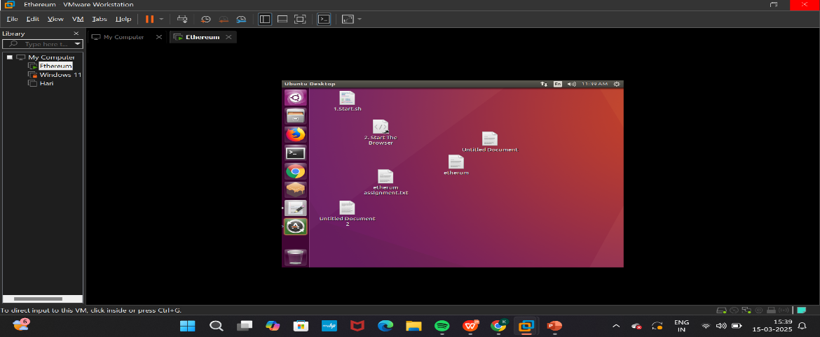
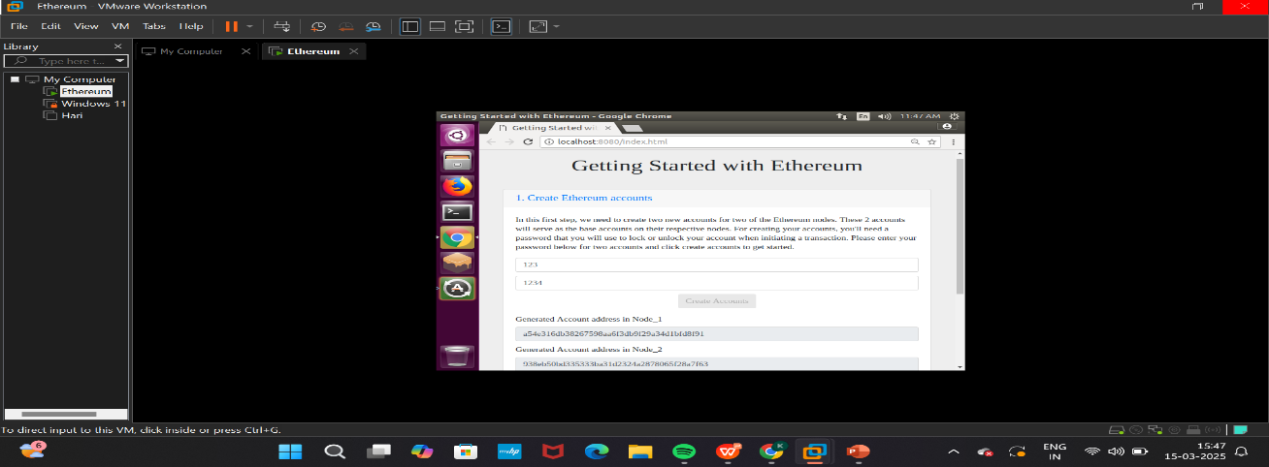
Output & Result
Fig 1: Install VMware and Configure Virtual Machines
Fig 2: Setting up Ethereum Environment

Slide 14
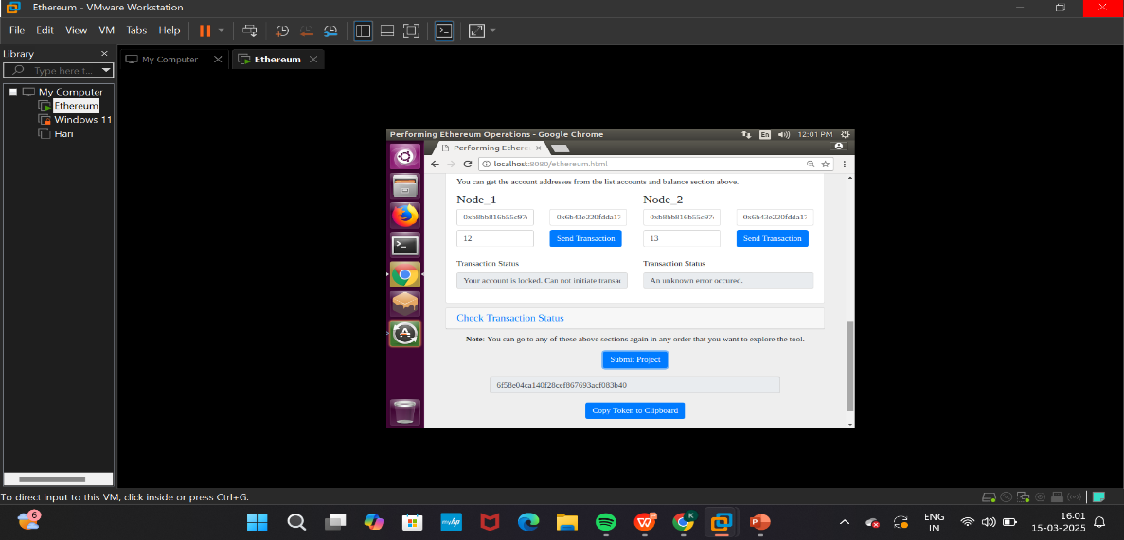
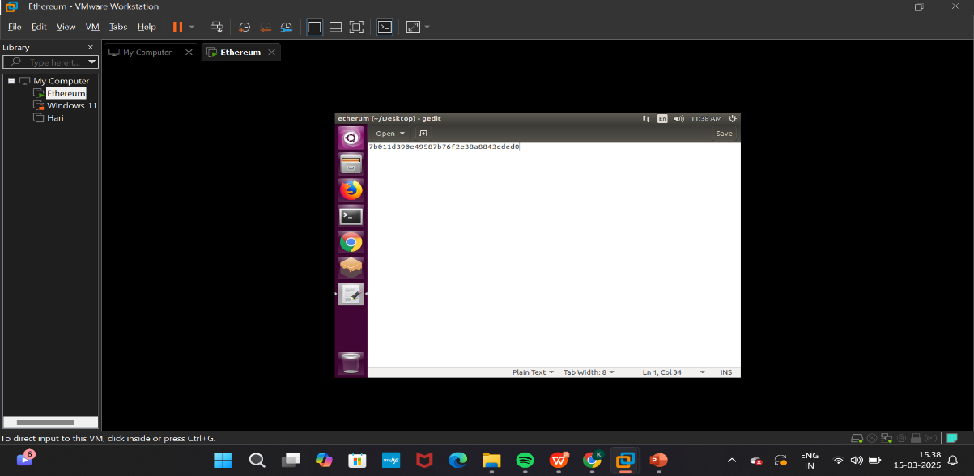
Output & Result
Fig 3: Set Up VMware Networking for Node Communication
Fig 4: Deployment and Testing Transactions

Slide 15
Conclusion
Blockchain technology is transforming the digital world by ensuring security, transparency, and decentralization. This project successfully demonstrates the fundamental concepts of blockchain, including mining, transactions, and network visualization. It provides a strong foundation for further blockchain development and research.

